Slide 1
FPS - ACTIVE – Annual Benefits Statement and Remediable Service Statement

Slide 2
Purpose
The presentation is designed to provide ACTIVE members with an overview of their Annual Benefit Statement and Remediable Service Statement.
Additionally, the presentation will cover Contribution Adjustments.
As this is an overview, it will not be possible to answer queries specifically to a member personal circumstances or amounts. However, time is set aside to ask questions and clarifications.

Slide 3
Areas to be Covered
Section 1
Page 1 to 7:
Initial pages / Terminology and
Death Grant Nominations.
Question / Clarifications.
Section 2
Page 8 - 12:
When Can I retire?
Reduction Factors.
Projected Pension at 60.
Question / Clarifications.
Section 3
Page 13 – 14
Contribution Adjustments
Interest
Tax Adjustments
Final Question and Useful Links

Slide 4
How to get your ABS-RSS
https://members.lppapensions.co.uk
Click Pension Point (member log in) to log in or register.
Problems logging on contact LPPA Helpdesk 0300 323 0260
Opening Hours Monday – Thursday 9am – 5pm, Friday 9am – 4pm.
Member Contact Form https://www.lppapensions.co.uk/contact/contact-lppa/

Slide 5
ABS-RSS: Page 1
Annual Benefit Statement and Remediable Service Statement (ABS-RSS).
As an active member with service in the remedy period, this document will provide you with details of the pension you are building up in the Firefighters' Pension Scheme 2015 (reformed scheme) as well as the rolled back position of your benefits in your legacy scheme FPS 1992, FPS 2006 and Modified.
The ABS-RSS will provide you with illustrations to allow you to compare the benefits available to you in relation to your membership between 1 April 2015 and 31 March 2022 (known as the remedy period).
Members Name

Slide 6
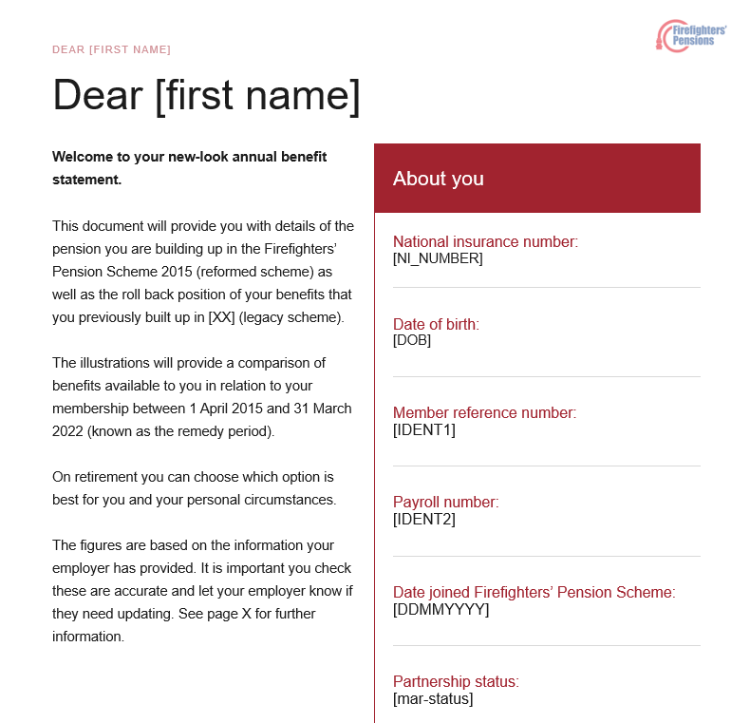
ABS-RSS: Page 2
Terminology
“Reformed Scheme” – FPS2015
“Legacy Scheme” – Member specific;
- FPS1992 (started pre-April 2006), FPS2006 (started post April 2006), or Special 2006 (part of Matthews 1).
“Roll Back Position” – This is the position if you had not been put into FPS2015 for the remedy period be that from 1 April 2015 or later if tapered member.
“Provide Comparison” – The document will show both your roll back pension and a pension if you elect to be in FPS2015 for the remedy period.
“Remedy Period” – 1 April 2015 to 31 March 2022. Nb – from 1 April 2022 all members moved into FPS2015.
“On retirement” – Your final decision on what scheme you want to do in the remedy period will be made at retirement, this is known as “deferred choice”

Slide 7
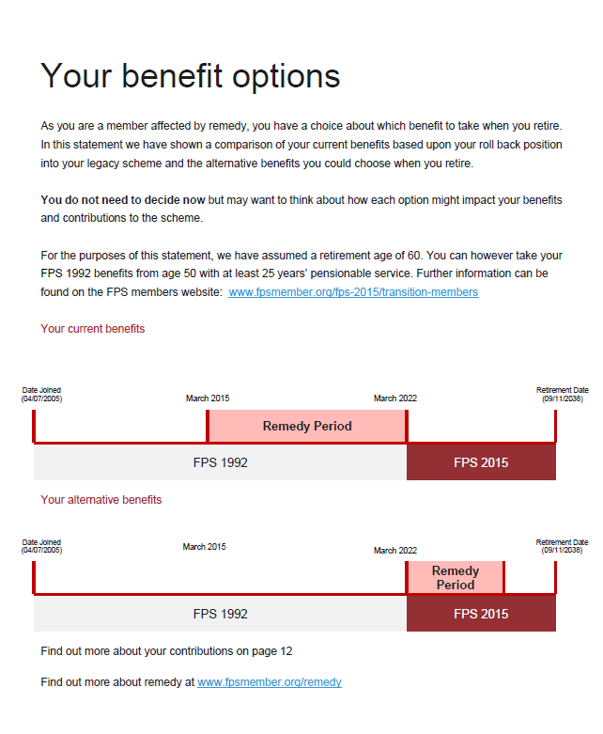
ABS-RSS: Page 3
Noteworthy;
“You have a choice about which benefit to take when you retire”
“may want to think about … contributions to the scheme”
“For the purposes of this statement, we have assumed a retirement age of 60.”
= Roll Back into Legacy
Day before 60th
Infographic
Date Joined
Current benefits = Rolled back into legacy scheme
Alternative benefits = in “reformed scheme” from 1 April 2015
Legacy Scheme
= In FPS2015 for full Period
Day before 60th
Date Joined
Date Joined
Day before 60th
Legacy Scheme
Legacy Scheme

Slide 8
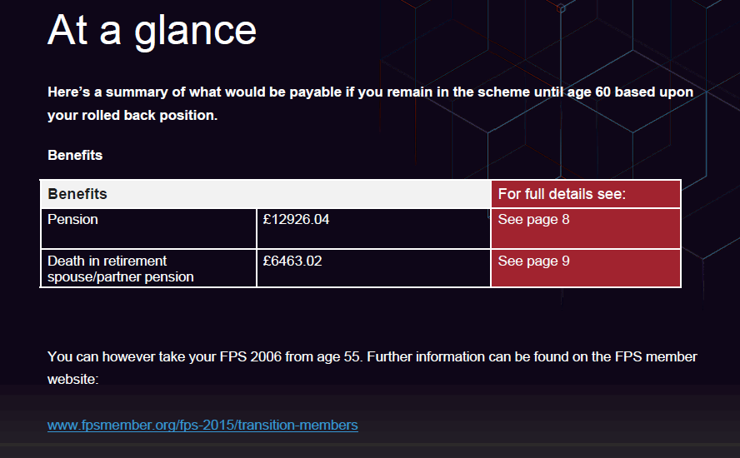
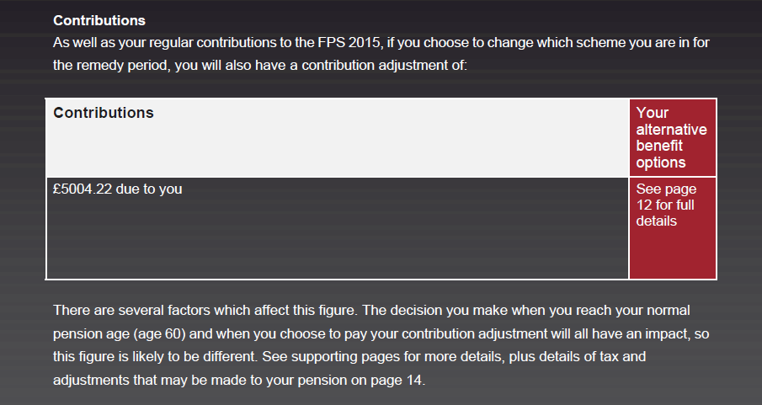
ABS-RSS: Page 4
This is a summary of your rolled back position for benefit built up until 31 March 2024, and not projected until age 60.
Note the “page 8” amount will be different, this amount is shown on “page 5”.
Note – Figure stated is for “Death in retirement spouse/partner.” Shown 50% of the above figure.
For the avoidance of doubt – the figures provided are what you have built up so far (as of 31 March 2024) if you remain in the scheme until 60. It does reflect the additional pension you will build up from 1 April 2024 to retirement at 60.
£ Amount
£ Amount
£ Amount
“Contributions” will be covered later in the presentation.

Slide 9
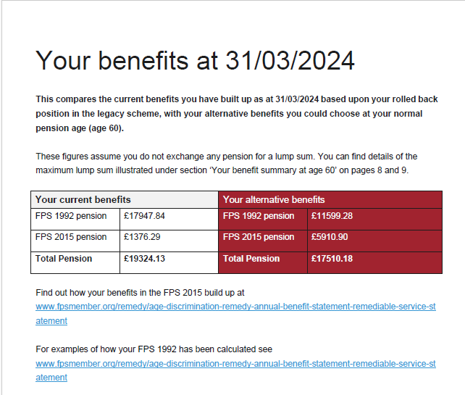
ABS-RSS: Page 5
Terminology
“Current Benefits” – Rolled back benefits, i.e. your benefits if you remained in your legacy scheme in the remedy period.
“Alternative Benefits” – Benefits if you choose to be in FPS2015 from 1 April 2015.
For FPS1992 and Special 2006 would assume “current benefits” would be higher values. FPS2006 could be based on individual career path.
£ Amount
£ Amount
£ Amount
£ Amount
Noteworthy;
“Benefits as at 31/03/2024” that would be payable at 60. Does not take into consideration benefits built up after 31/03/2024 until age 60.
“Assume you do not exchange for a lump sum” – these figures do not take to account any lump sum calculations.
“Total Pension” is the figure you should see on the “at a glance” page.
£ Amount
£ Amount

Slide 10
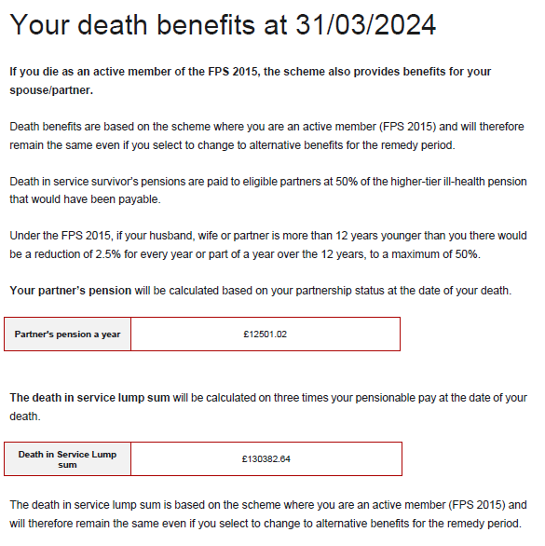
ABS-RSS: Page 6
Death of an active scheme member.
Members with an equivalent FPS 1992 portion of pension, will be paid under FPS 2015.
If they not married when they die, a cohabiting partner will still be entitled to half of the equivalent FPS 1992 entitlement as well as the FPS 2015 portion.
However, If not married when they die, but have retired, then only the FPS2015 proportion is payable and the FPS1992 is not applicable to cohabiting partner.
Your choice of Current or Alternative will not impact this figure, as all members are in FPS2015 from 1 April 2022.
£ Amount
£ Amount
https://fpsmember.org/fps-2015/survivors-pension
https://fpsmember.org/fps-2015/childrens-pension

Slide 11
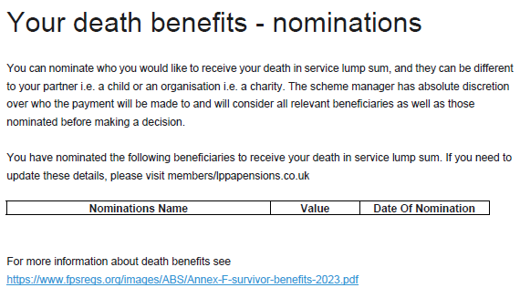
Noteworthy;
“Receive your death in service lump sum” – this is not an election to receive “survivors” pension.
ABS-RSS: Page 7
The FRA has absolute discretion who to pay the death grant to, but you may nominate the person(s) that you would like to receive it. The authority would take your wishes into account when making their decision.
If incorrect, or blank then the form can be found at: https://www.lppapensions.co.uk/members/forms-and-documents/
All You Need To know About Nominating A Beneficiary - https://www.lppapensions.co.uk/news-hub/everything-you-need-to-know-about-nominating-a-beneficiary/

Slide 12
Questions
Still to be covered;
When can I retire?
Pension at 60
“Information we have used”
Contribution Adjustments

Slide 13
When Can I Retire?
Noting ABS is based on retirement age 60

Slide 14
FPS1992

Slide 15
When Can I retire? FPS1992 and FPS2015 benefits
From age 50 with at least 25 years of service
FPS1992 – Payable immediately, but lump sum is restricted
FPS2015 – Deferred until State Pension Age. Can take from 55 but with reductions.
Noteworthy;
Service is your combined pensionable service in FPS1992 and FPS2015
From age 50 but before 55, with 30 years of service
FPS1992 – Payable immediately
FPS2015 – Deferred until State Pension Age. Can take from 55 but with reductions.
Useful Link
Retirement Decision Tree
https://fpsmember.org/sites/default/files/FPS-1992-2015-retirement-decision-tree.pdf
From age 55 but before 60
FPS1992 – Payable immediately
FPS2015 - Payable immediately, but with reductions.
From age 60
FPS1992 – Payable immediately
FPS2015 - Payable immediately, but without reductions.

Slide 16
Special 2006 - Modified

Slide 17
When Can I retire? Modified and FPS2015 benefits
From age 55 but before 60
Modified – Payable immediately
FPS2015 - Payable immediately, but with reductions.
From age 60
Modified – Payable immediately
FPS2015 - Payable immediately

Slide 18
FPS2006

Slide 19
When Can I retire? FPS2006 and FPS2015 benefits
From age 55 to age 60
FPS2006 – Payable immediately but with reductions, could defer until 65.
From age 60
FPS2015 – Payable immediately without reductions.
FPS2015 – Payable immediately but with reductions, could defer until State Pension Age.
FPS2006 – Payable immediately without reductions.
Useful Link
Retirement Decision Tree
https://fpsmember.org/sites/default/files/FPS-2006-2015-retirement-decision-tree.pdf

Slide 20
Age | NFPS2006 reduction factors from Active | NFPS2006 reduction factors from Deferred | FPS2015 reduction factors from ACTIVE | FPS2015 reductions from Deferred Status*
55 | 38.00% | 38.00% | 20.00% | 46.80%
56 | 35.40% | 35.40% | 16.60% | 44.60%
57 | 32.60% | 32.60% | 12.90% | 42.30%
58 | 29.50% | 29.50% | 8.90% | 39.80%
59 | 26.30% | 26.30% | 4.60% | 37.10%
60 | Paid in Full | 22.80% | Paid in Full | 34.20%
61 |  | 18.90% |  | 31.10%
62 |  | 14.80% |  | 27.80%
63 |  | 10.30% |  | 24.10%
64 |  | 5.40% |  | 20.10%
65 |  | Paid in Full |  | 15.80%
66 |  |  |  | 11.00%
67 |  |  |  | 5.80%
68 |  |  |  | Paid in Full
REDUCTION FACTORS

Slide 21
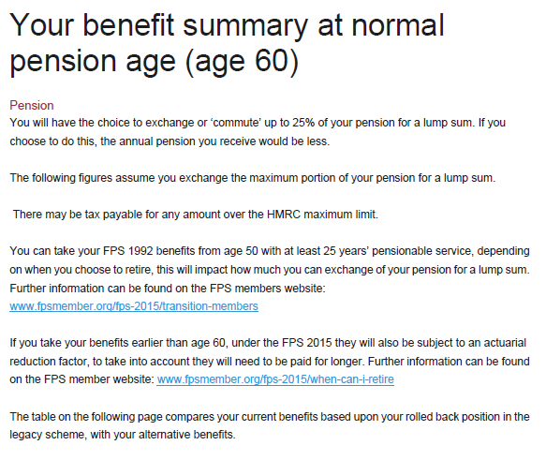
Based on retiring at 60 – No reduction factors are built into calculation.
Could choose to commute pension from 0% to 25%.
Commutation factor for FPS2006 and FPS2015 is £12. E.g. for every £1 commuted, equates to £12 lump sum.
FPS1992 commutation at 60 is currently 20.6. E.g. for every £1 commuted, equates to £20.60 lump sum.
When can I retire, decision trees, and reductions covered in previous slides.

Slide 22
FPS1992 – Commutation Factors
https://fpsmember.org/sites/default/files/Commutation_on_retirement_Factors_and_Guidance.pdf

Slide 23
Terminology
“Current Benefits” – Rolled back benefits, i.e. your benefits if you remained in your legacy scheme in the remedy period.
“Alternative Benefits” – Benefits if you choose to be in FPS2015 from 1 April 2015.
For FPS1992 and Special 2006 would assume “current benefits” would be higher values.
FPS2006 could be based on individual career path.
Benefits listed for A and B are projected forward until age 60. No reductions.
Part A shows pension without commutation
Part B shows pension with commutation. But does not reflect any potential tax on lump sum.
ABS-RSS: Page 8 and Page 9
£ Amount
£ Amount
£ Amount
£ Amount
£ Amount
£ Amount
£ Amount
£ Amount
£ Amount
£ Amount
£ Amount
£ Amount
£ Amount
£ Amount
£ Amount
£ Amount
£ Amount
£ Amount

Slide 24
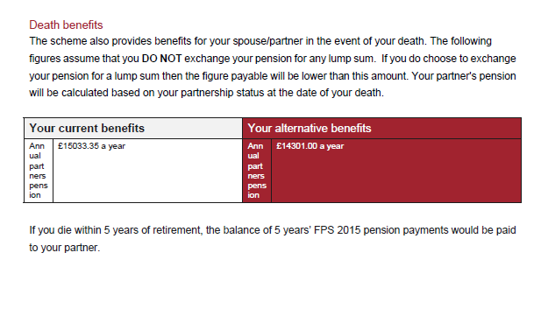
Noteworthy;
These are benefits payable after retirement and in the event of the members death.
Note the survivor’s pension is 50% of the pension after commutation.
Previously discussed impact of not being married and FPS1992 element for death after retirement.
£ Amount
£ Amount

Slide 25
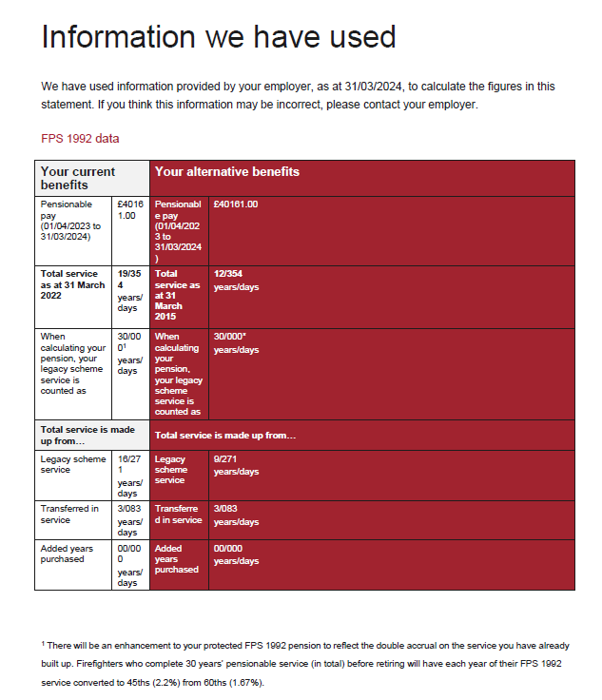
£
£Amount
Pensionable pay is the average for 1/4/2023 to 31/3/2024. It is not your current pay, or the pay as at 31/3/2024
Years / Days
Total Service + Transferred in Service + Added Years = Note the difference between current and alternative is 7 years, i.e the remedy period.
Years / Days
FPS1992 – Double Accruals
Note the difference between current and alternative is 7 years, i.e the remedy period.
Years / Days
Years / Days
Transferred in service, outside any fire service transfer
Years / Days
Added years purchased, if any.

Slide 26
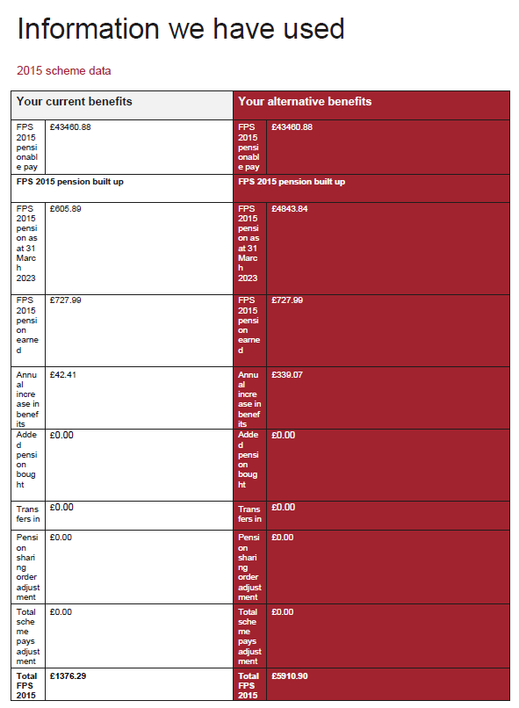
£ Amount
£ Amount
CARE pay received in 1.4.2023 to 31.03.2024. Not Pension entitlement.
£ Amount
£ Amount
For current benefits = FPS2015 built up from 1.4.2022 to 31.03.2023 = 1 year.
For alternative benefits = FPS2015 built up from 1.4.2015 to 31.03.2023 = 8 years.
£ Amount
£ Amount
For both current and alternative, this is FPS2015 for 1.4.2023 to 31.03.2024 = 1 Year.
£ Amount
£ Amount
This is the revaluation of benefits up to 01.04.2015 to a 31.03.2024 value.
£ Amount
£ Amount
The value of any added pension payments.
£ Amount
£ Amount
The value of any transfer in amounts.
£ Amount
£ Amount
The value of any pension sharing orders in place.
£ Amount
£ Amount
£ Amount
£ Amount
The total FPS2015 built up as of 31.03.2024. Not projected forward.

Slide 27
Questions
Still to be covered;
Contribution Adjustments

Slide 28
What and Why?
Pensionable pay | FPS1992 and Modified | FPS2006 | FPS2015
Up to and including £15,609 | 11.00% | 8.50% | 11.00%
More than £15,609 and up to and including £21,852 | 12.20% | 9.40% | 11.00%
More than £21,852 and up to and including £27,818 | 14.20% | 10.40% | 11.00%
More than £27,818 and up to and including £31,218 | 14.20% | 10.40% | 12.90%
More than £31,218 and up to and including £41,624 | 14.70% | 10.90% | 12.90%
More than £41,624 and up to and including £51,515 | 15.20% | 11.20% | 12.90%
More than £51,515 and up to and including £52,030 | 15.20% | 11.20% | 13.50%
More than £52,030 and up to and including £62,436 | 15.50% | 11.30% | 13.50%
More than £62,436 and up to and including £104,060 | 16.00% | 11.70% | 13.50%
A contribution adjustment is required to take into account under or overpaid contributions in the remedy period
The Employee contribution rates across FPS1992 and Modified Scheme, FPS2006 and FPS2015 are different.
FPS1992* – Highest
FPS2015 – Middle
FPS2006 – Lowest

Slide 29
HOW AM I AFFECTED -FPS1992 AND MODIFIED

Slide 30
FPS1992 and Modified - How am I impacted?
MEMBER TYPE
PROTECTED MEMBER
UNPROTECTED MEMBER
TAPER PROTECTED
Criteria
Legacy FPS1992* and born before 1 April 1967.
Legacy FPS1992* and born after 1 April 1971.
Legacy FPS 1992* and born between 2 April 1967 and 1 April 1971.
If remaining in Roll Back / “Current Benefits”
No Contribution Adjustment Required.
UNDERPAID PENSION CONTRIBUTIONS for full remedy period.
UNDERPAID PENSION CONTRIBUTIONS from taper date until 31 March 2022.
If elect for FPS2015
Could elect for refund at retirement if choose FPS2015 from 1 April 2015.
No adjustment required.
OVERPAID Pension Contributions before taper date. Refund at retirement if choose FPS2015.
Joined FPS2015
1 April 2022
1 April 2015
Between 1 April 2015 and 31 March 2022

Slide 31
HOW AM I AFFECTED –FPS2006

Slide 32
FPS2006 - How am I impacted?
MEMBER TYPE
PROTECTED
UNPROTECTED
TAPER PROTECTED
Criteria
Legacy FPS2006 and born before 1 April 1962.
Legacy FPS2006 and born after 1 April 1966.
Legacy FPS 2006 and born between 2 April 1962 and 1 April 1966.
If remaining in Roll Back / “Current Benefits”
No Contribution Adjustment Required.
OPVERPAID PENSION CONTRIBUTIONS for full remedy period = REFUND
OVERERPAID PENSION CONTRIBUTIONS from taper date until 31 March 2022.
If elect for FPS2015
Could elect to pay at retirement if choose FPS2015 from 1 April 2015.
No adjustment required if not previously elected for refund.
UNDERPAID Pension Contributions before taper date.
Pay additional at retirement if choose FPS2015.
Joined FPS2015
1 April 2022
1 April 2015
Between 1 April 2015 and 31 March 2022

Slide 33
FPS1992 AND MODIFIED

Slide 34
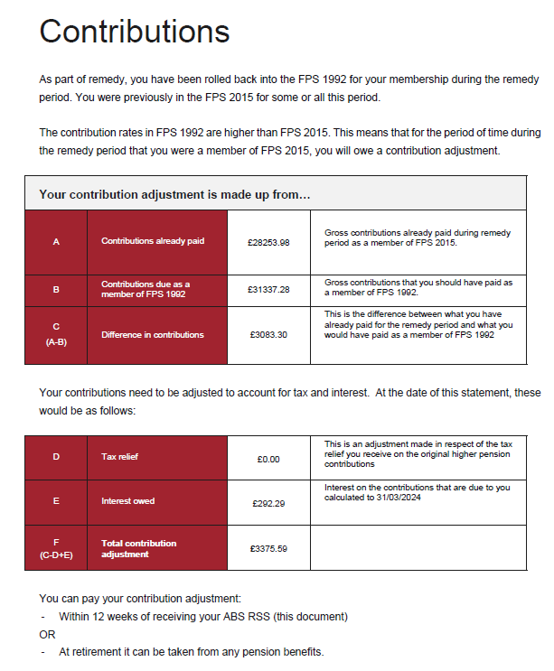
ABS-RSS: Page 12
£ Amount
Contributions already paid for remedy period
£ Amount
Contributions required to be considered in FPS1992/Modified for remedy period
£ Amount
Contributions shortfall
“Last minute change” – if buying back tax relief will be calculated.
£ Amount
Charged interest on contributions over remedy period
£ Amount
Total amount required. Will need to be recalculated for tax relief
£ Amount
12-week window opens up every year with each ABS
Or at retirement

Slide 35
FPS 1992 & Special FPS 2006 options
Settle now
Interest charged at NS&I saver rate until date of payment
Settle at next RSS or retirement
Interest charged at NS&I rate until date of payment
Choice remains at retirement:
Legacy benefits = no further contribution adjustment
Reformed benefits = contributions refunded (plus interest at NS&I rate).
Choice remains at retirement:
Legacy benefits = contribution adjustment required (can be done from lump sum)
Reformed benefits = no contribution adjustment required.

Slide 36
FPS2006

Slide 37
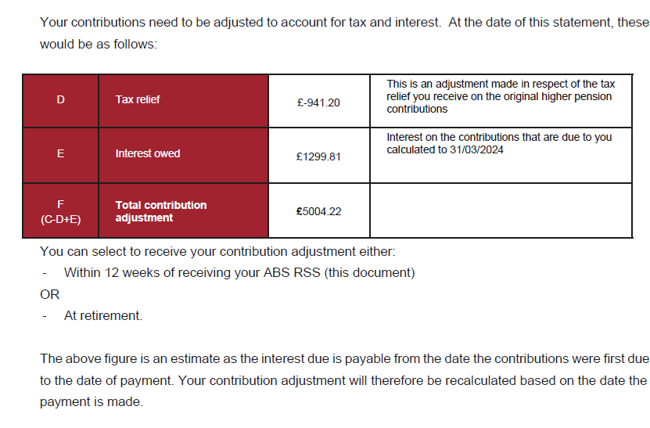
Contributions (2006)
ABS-RSS: Page 12
£ Amount
Contributions already paid for remedy period
£ Amount
Contributions required to be considered in FPS2006 for remedy period
£ Amount
Contributions “overpaid”
£ Amount
Tax relief originally received is deducted.
£ Amount
Receive interest on contributions overpaid.
£ Amount
Total amount to be refunded after tax and interest.
Can be claimed at any point up to retirement
Interest will continue to be added until any payment is made.

Slide 38
FPS 2006
Accept Refund at any point up to retirement
Interest accrued at 8% until 28 days from initial RSS (NS&I thereafter)
Settle at retirement
Interest accrued at 8% until 28 days from initial RSS (NS&I thereafter)
Choice remains retirement:
Legacy benefits = no further contribution adjustment
Reformed benefits = contributions to be repaid (plus interest at NS&I rate).
Choice remains at retirement:
Legacy benefits = contributions to be refunded
Reformed benefits = no contribution adjustment required.

Slide 39
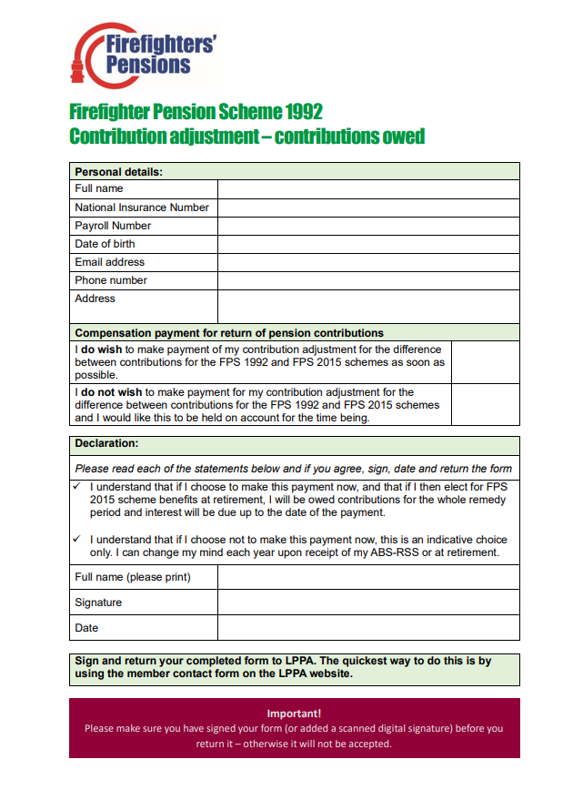
LPPA website in Forms and Documents
https://www.lppapensions.co.uk/members/forms-and-documents/
LPPA will send form to CFRS
CFRS will calculate contribution, calculating any additional interest, a tax adjustment, and send letter to advise member of how to make the payment.

Slide 40
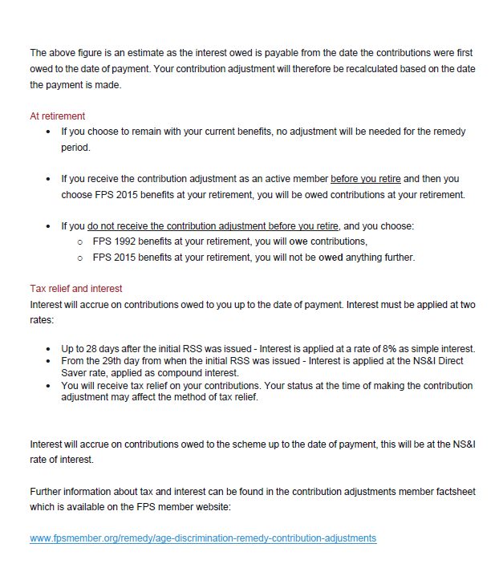
Remember – you will not have to decide on what benefits you want to take until retirement. Even if you have elected for a contribution adjustment – refund or payment.

Slide 41
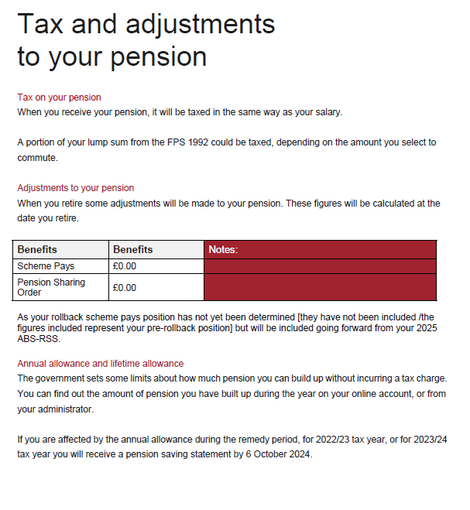
For members who have previously paid AA charge.
If you have a PSO in place.
If you have had a R-PSS then any scheme pays are not shown until next years document.

Slide 42
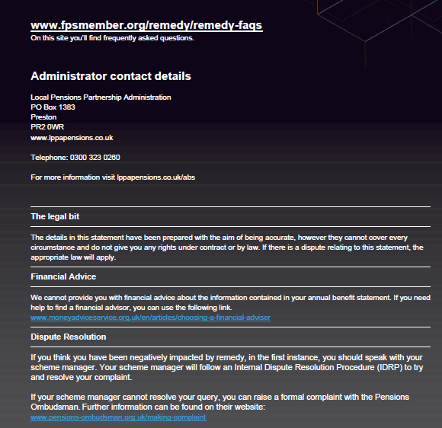
FF Pension Member Website – Remedy pages
https://fpsmember.org/remedy
LPPA
https://www.lppapensions.co.uk/

Slide 43
Disclaimer
• The information contained in these slides are the authors interpretation of the current regulations.
• The information is provided solely for use for active members of the Firefighter Pension Scheme at Cumbria Fire and Rescue Service and is for illustration purposes only.
• Readers should take their own legal advice on the interpretation of any particular piece of legislation.
• No responsibility whatsoever will be assumed by Cumbria Fire and Rescue Service or their partners for any direct or consequential loss, financial or otherwise, damage or inconvenience, or any other obligation or liability incurred by readers relying on information contained in these slides.

Slide 44
Final Questions

